Slide 1
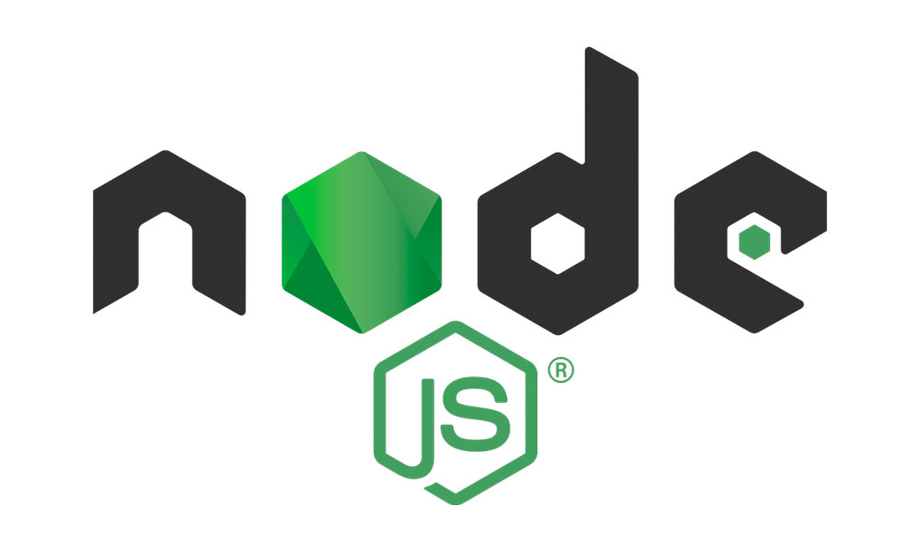
REPL in Node JS
A Read-Eval-Print Loop, or REPL, is a computer environment where user inputs are read and evaluated, and then the results are returned to the user.

Slide 2
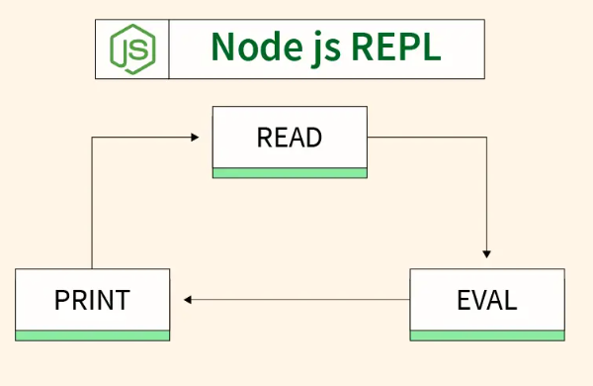
Read : Reads user’s input, parses the input into Javascript data-structure, and stores in memory.
Eval : Takes and evaluates the data structure.
Print : Prints the result.
Loop : Loops the above command until the user presses ctrl-c twice.

